Slide 2
semicolon
Agenda
Introduction
Meet The Team
Why ; ?
Client Requirements – Challenges
Client Requirements – Goals
semicolon; Solution
Next Steps
;

Slide 3
Agenda
;
semicolon
Introduction
Introduction
Meet The Team
Why ; ?
Client Requirements – Challenges
Client Requirements – Goals
semicolon; Solution
Next Steps
Client: Todd – Tomorrow’s Voice
Team: semicolon;
Project Name: TomorrowsVoice;
Presentation Overview: To optimize and enhance the current Choir Administration and Volunteer Management systems.

Slide 4
Introduction
Agenda
;
semicolon
Client: Todd – Tomorrow’s Voice
Team: semicolon;
Project Name: TomorrowsVoice;
Presentation Overview: To optimize and enhance the current Choir Administration and Volunteer Management systems.
Introduction
Meet The Team
Why ; ?
Client Requirements – Challenges
Client Requirements – Goals
semicolon; Solution
Next Steps

Slide 5
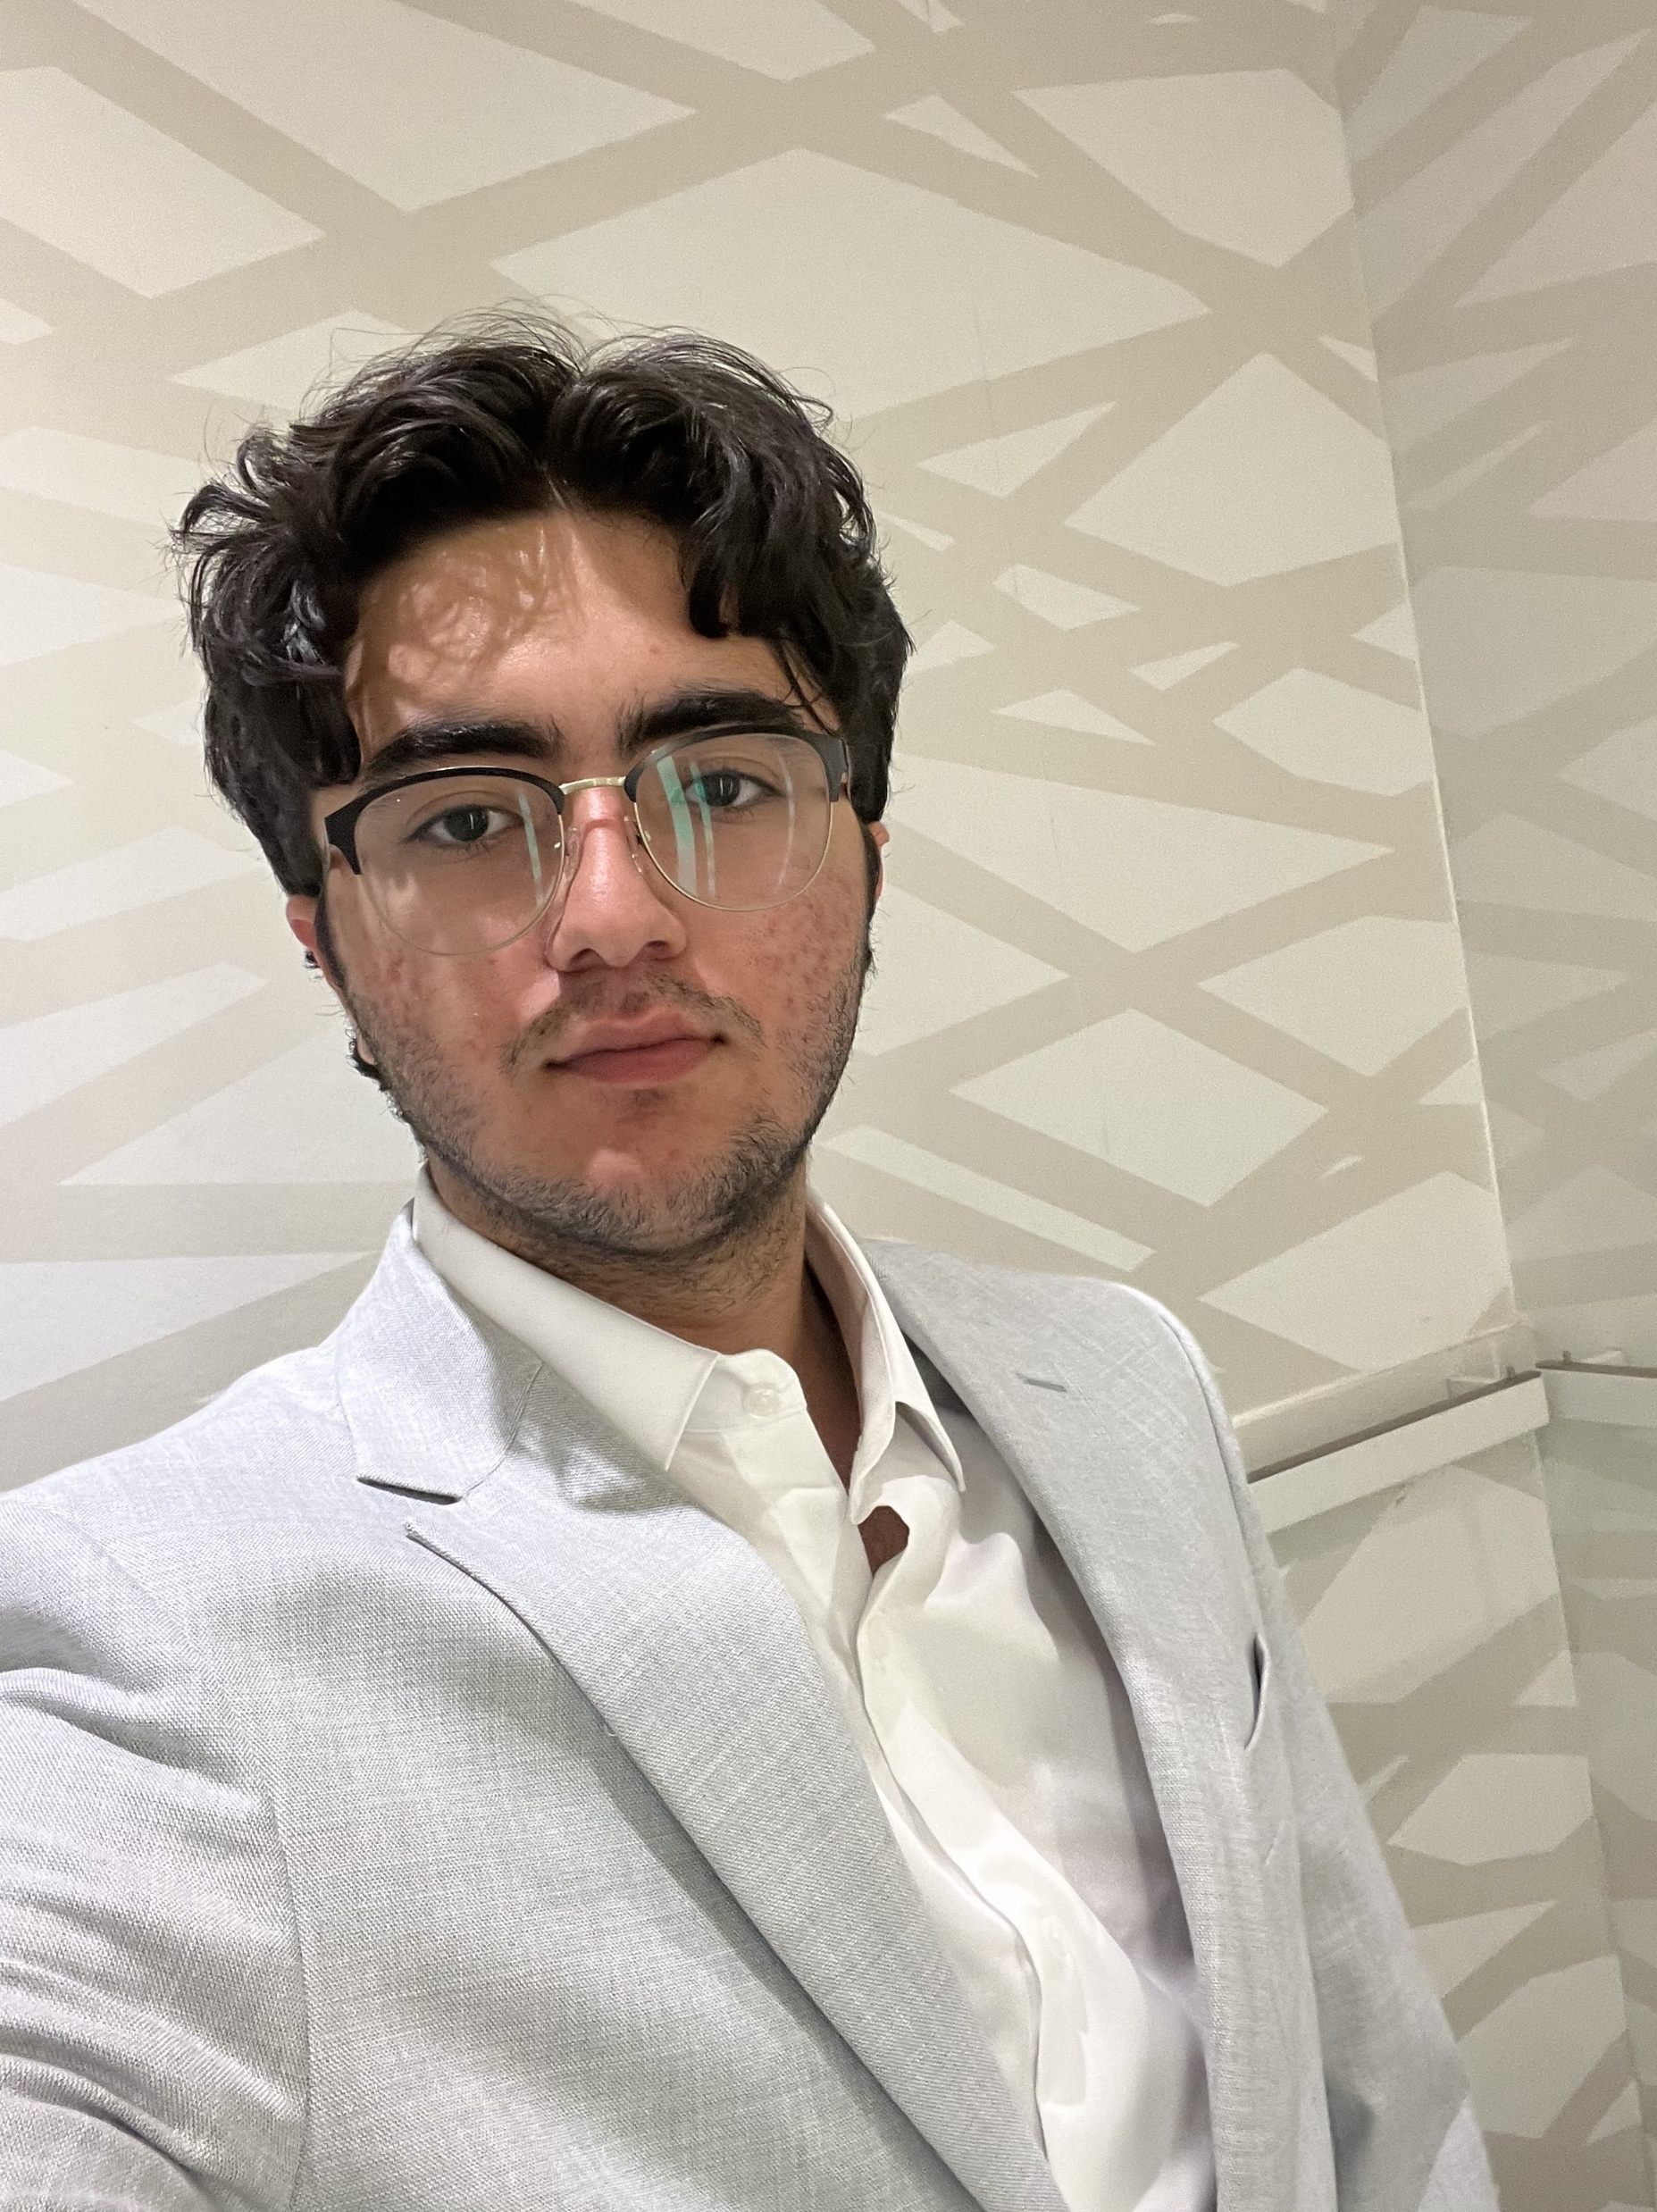
Meet the Team
Introduction
;
semicolon
Client: Todd – Tomorrow’s Voice
Team: semicolon;
Project Name: TomorrowsVoice;
Presentation Overview: To optimize and enhance the current Choir Administration and Volunteer Management systems.
Radin Shahravan
Team Lead;
Communications Manager

Slide 6
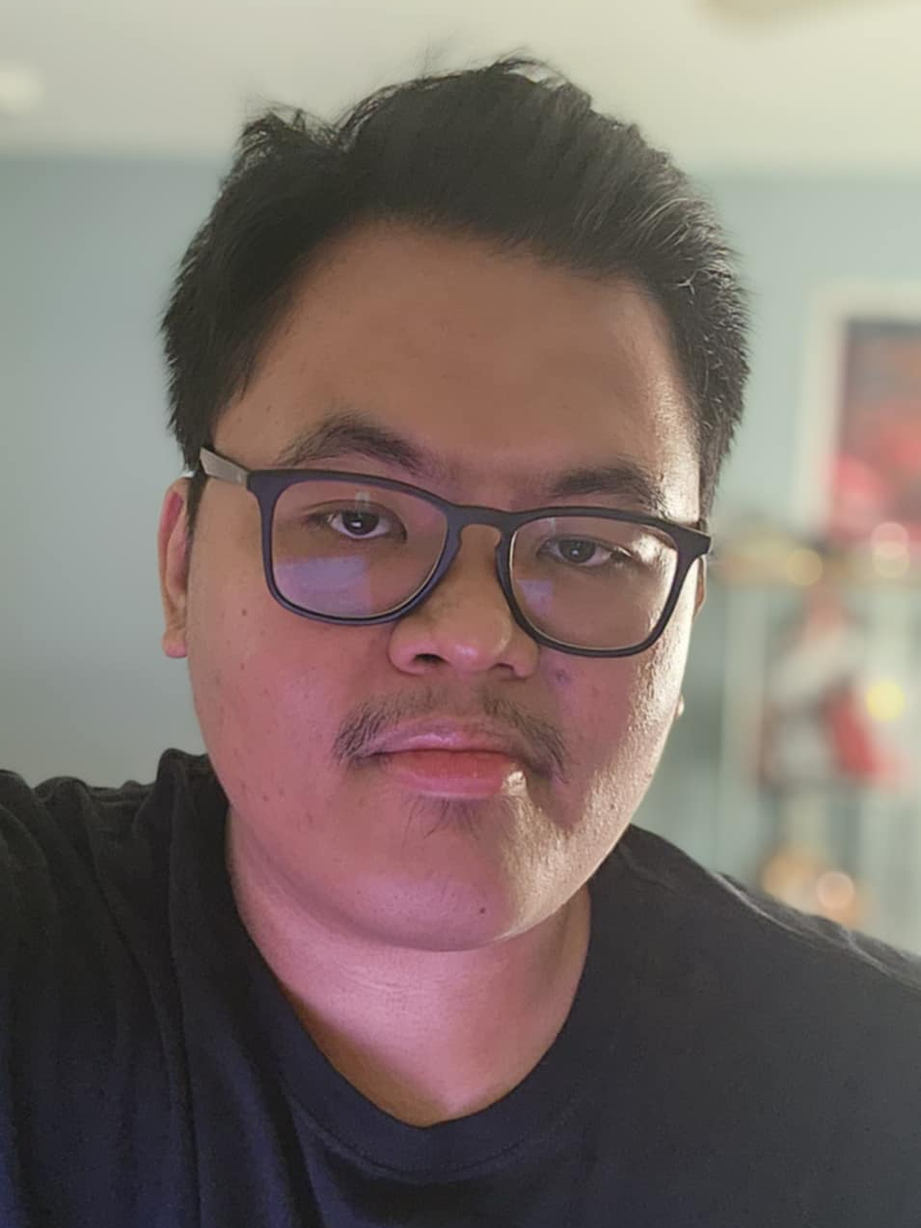


Meet the Team
;
semicolon
Radin Shahravan
Team Lead;
Communications Manager
Nyle Bumanglag
GitHub Manager; Disaster Recovery Manager
Sahil Patel
Team Scheduler;
Azure Hoster
Mohammad Yaseen
Presentation Coordinator

Slide 7
Meet the Team
;
semicolon
Radin Shahravan
Team Lead;
Communications Manager
Nyle Bumanglag
GitHub Manager; Disaster Recovery Manager
Sahil Patel
Team Scheduler;
Azure Hoster
Mohammad Yaseen
Presentation Coordinator

Slide 8
Meet the Team
;
semicolon
Radin Shahravan
Team Lead;
Communications Manager
Nyle Bumanglag
GitHub Manager; Disaster Recovery Manager
Sahil Patel
Team Scheduler;
Azure Hoster
Mohammad Yaseen
Presentation Coordinator

Slide 9
Meet the Team
;
semicolon
Radin Shahravan
Team Lead;
Communications Manager
Nyle Bumanglag
GitHub Manager; Disaster Recovery Manager
Sahil Patel
Team Scheduler;
Azure Hoster
Mohammad Yaseen
Presentation Coordinator

Slide 10
;
semicolon
We’re a team of dedicated and skilled programmers, working to bring about the best results according to your requirements.
We’re optimised, efficient, and well versed with our work, with experience in our areas of expertise, upholding standard and quality with our product and services.
Why ; ?
We uphold TIME as one of core crucial currencies. Ours and yours!
Your application is bound to crash if you don’t have us. ;)

Slide 11
;
semicolon
Why ; ?
We’re a team of dedicated and skilled programmers, working to bring about the best results according to your requirements.
We’re optimised, efficient, and well versed with our work, with experience in our areas of expertise, upholding standard and quality with our product and services.
We uphold TIME as one of core crucial currencies. Ours and yours!
Your application is bound to crash if you don’t have us. ;)

Slide 12
;
semicolon
Why ; ?
We’re a team of dedicated and skilled programmers, working to bring about the best results according to your requirements.
We’re optimised, efficient, and well versed with our work, with experience in our areas of expertise, upholding standard and quality with our product and services.
We uphold TIME as one of the core crucial currencies. Ours and yours!
Your application is bound to crash if you don’t have us. ;)

Slide 13
;
semicolon
Why ; ?
We’re a team of dedicated and skilled programmers, working to bring about the best results according to your requirements.
We’re optimised, efficient, and well versed with our work, with experience in our areas of expertise, upholding standard and quality with our product and services.
We uphold TIME as one of the core crucial currencies. Ours and yours!
Your application is bound to crash if you don’t have us. ;)

Slide 14
Client Requirements - Challenges
;
semicolon
Why ; ?
We’re a team of dedicated and skilled programmers, working to bring about the best results according to your requirements.
We’re optimised, efficient, and well versed with our work, with experience in our areas of expertise, upholding standard and quality with our product and services.
We uphold TIME as one of the core crucial currencies. Ours and yours!
Your application is bound to crash if you don’t have us. ;)

Slide 15
Client Requirements - Challenges
;
semicolon
Choir Administration
Geographically Dispersed Operations
Attendance Tracking
Communication Needs
Volunteer Management
Current State – Google Sheet Signup
Future Expansion
Data Management
Reminders

Slide 16
Client Requirements - Challenges
;
semicolon
Choir Administration
Geographically Dispersed Operations
Attendance Tracking
Communication Needs
Volunteer Management
Current State – Google Sheet Signup
Future Expansion
Data Management
Reminders

Slide 17
Client Requirements - Challenges
;
semicolon
Choir Administration
Geographically Dispersed Operations
Attendance Tracking
Communication Needs
Volunteer Management
Current State – Google Sheet Signup
Future Expansion
Data Management
Reminders

Slide 18
Client Requirements - Goals
;
semicolon
Choir Administration
A centralized system to track weekly attendance.
A communication between directors and management; updates on weekly sessions.
Volunteer Management
A platform to make volunteer sign-ups more efficient.
Handle multiple events and programs.
A database that stores volunteer information.
Automated reminders for volunteers prior to assigned shifts.

Slide 19
Client Requirements - Goals
;
semicolon
Choir Administration
A centralized system to track weekly attendance.
A communication between directors and management; updates on weekly sessions.
Volunteer Management
A platform to make volunteer sign-ups more efficient.
Handle multiple events and programs.
A database that stores volunteer information.
Automated reminders for volunteers prior to assigned shifts.

Slide 20
semicolon; Solution
;
semicolon
Prototype 1:
Choir Administration
A database – data model

Slide 21
semicolon; Solution
;
semicolon
Prototype 1:
Choir Administration
A database – data model

Slide 22
semicolon; Solution
;
semicolon
Prototype 1:
Choir Administration
A database – data model
Director
Location
Singer
Attendance
Session

Slide 23
semicolon; Solution
;
semicolon
Prototype 1:
Choir Administration
A database – data model
Director
Location
Singer
Attendance
Session

Slide 24
semicolon; Solution
;
semicolon
Prototype 1:
Choir Administration
A database – data model
Director
Location
Singer
Attendance
Session

Slide 25
semicolon; Solution
;
semicolon
semicolon;
Prototype 1:
Choir Administration
A database – data model
Director
Location
Singer
Attendance
Session

Slide 26
semicolon; Solution
;
semicolon
Prototype 1:
Choir Administration
A database – data model
Director
Location
Singer
Attendance
Session

Slide 27
semicolon; Solution
;
semicolon
Prototype 1:
Choir Administration
Attendance Functionality
CRUD - Ability to Record Information

Slide 28
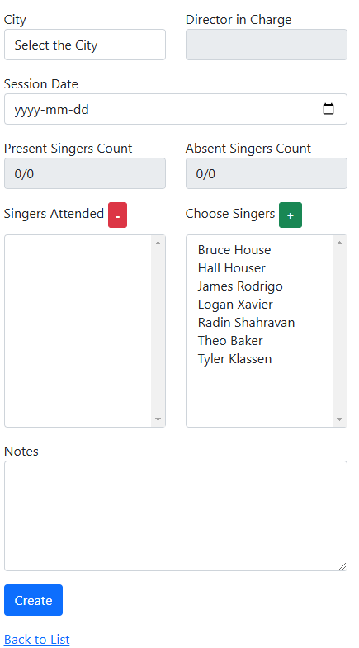
semicolon; Solution
;
semicolon
Prototype 1:
Choir Administration
Attendance Functionality
CRUD - Ability to Record Information

Slide 29
semicolon; Solution
;
semicolon
Prototype 1:
Choir Administration
Attendance Functionality
CRUD - Ability to Record Information

Slide 30
semicolon; Solution
;
semicolon
Prototype 1:
Choir Administration
Attendance Functionality
CRUD - Ability to Record Information

Slide 31
semicolon; Solution
;
semicolon
Prototype 1:
Choir Administration
Attendance Functionality
CRUD - Ability to Record Information

Slide 32
semicolon; Solution
;
semicolon
Prototype 1:
Choir Administration
Attendance Functionality
Export Reports on Collected Information

Slide 33
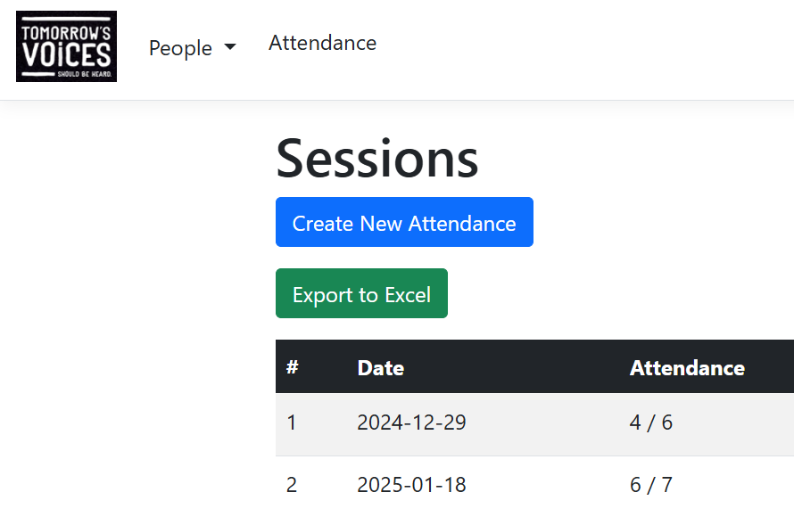
semicolon; Solution
;
semicolon
Prototype 1:
Choir Administration
Attendance Functionality
Export Reports on Collected Information

Slide 34
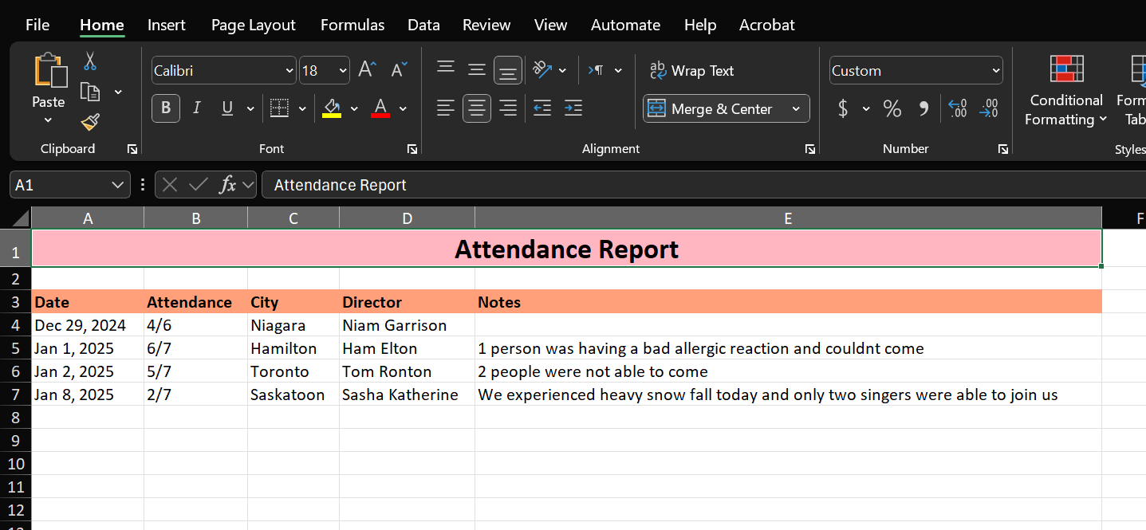
semicolon; Solution
;
semicolon
Prototype 1:
Choir Administration
Attendance Functionality
Export Reports on Collected Information

Slide 35
semicolon; Solution
;
semicolon
Prototype 1:
Choir Administration
Attendance Functionality
Export Reports on Collected Information

Slide 36
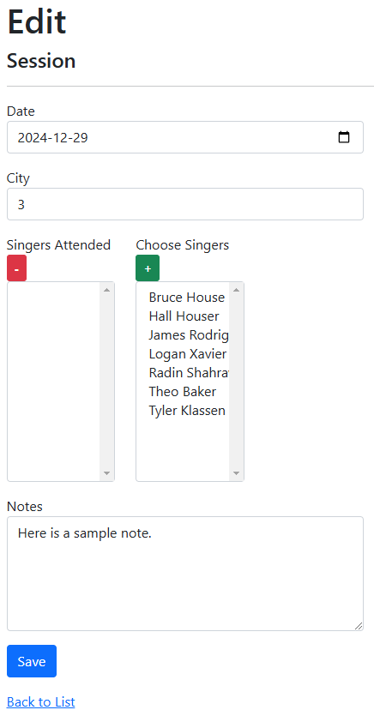
semicolon; Solution
;
semicolon
Prototype 1:
Choir Administration
Attendance Functionality
Notes Section

Slide 37
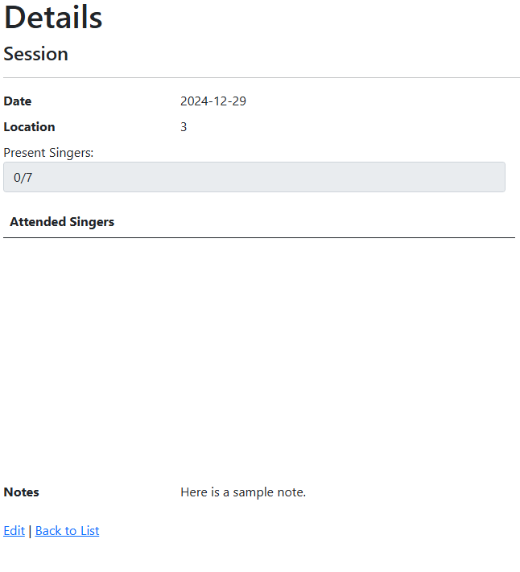
semicolon; Solution
;
semicolon
Prototype 1:
Choir Administration
Attendance Functionality
Notes Section

Slide 38
semicolon; Solution
;
semicolon
Prototype 1:
Choir Administration
Attendance Functionality
Notes Section

Slide 39
Next Steps
;
semicolon

Slide 40
Next Steps
;
semicolon
Get client feedback on current presentation and prototype.
Implement final feedback adjustments and any bug fixes.
Move forward with the project finalization.

Slide 41
;
semicolon
Thank you for your time and patience.

Slide 42
;
semicolon

